Slide 1
C++
Structures lecture 2

Slide 2
Last week -- structs

Slide 3
The problem
You have a bunch of related data you want to store
E.g. An employees name, age (or d.o.b.) and salary

Slide 4
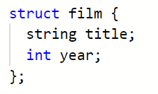

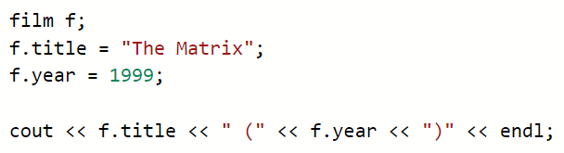
Solution – data structure

Slide 5
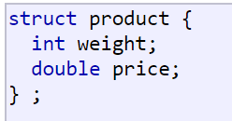
C++ structures
Data structure
Group of data elements grouped together under one name
Data elements are know as members

Slide 6
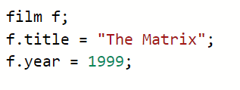

Use
Once declared structures are used like any other type

Slide 7
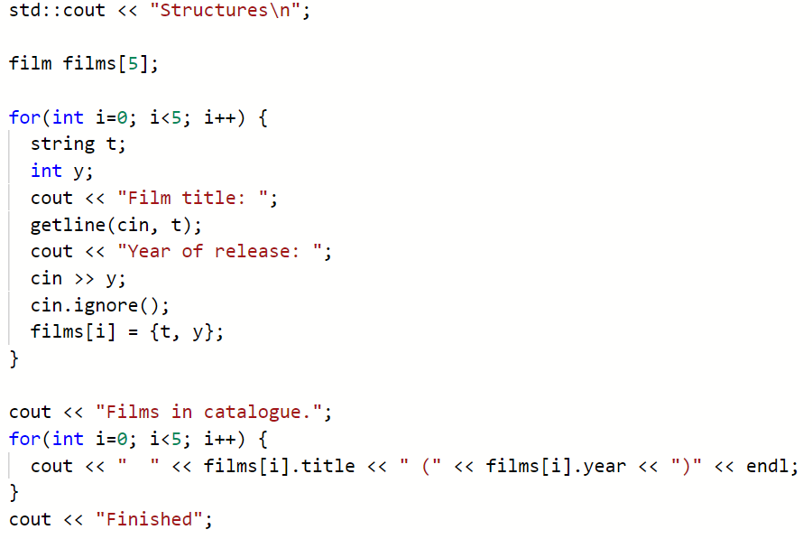
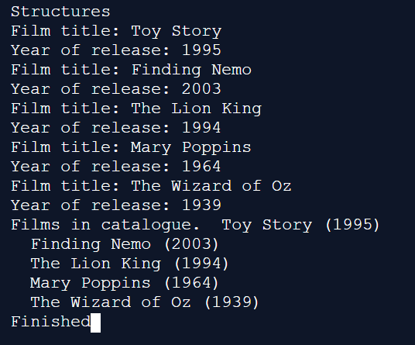

Slide 8
More structures

Slide 9
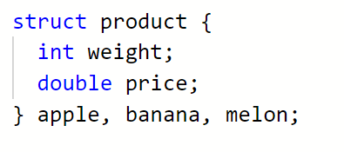

Declerations
This declaration creates a new type (product), which is then used to declare three variables of this type

Slide 10
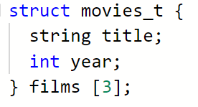
Array

Slide 11
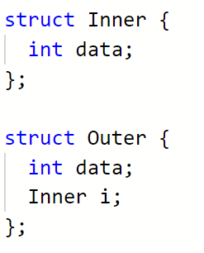

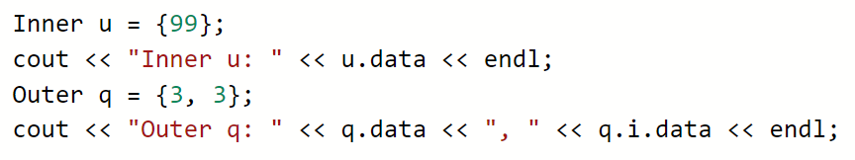
Structures inside structures

Slide 12
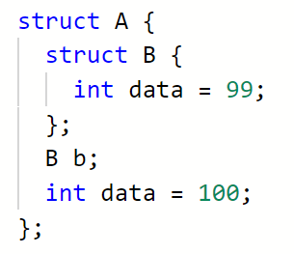

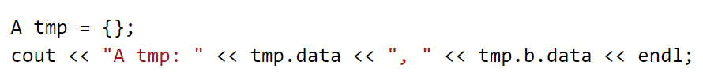
Default values

Slide 13
Tasks for this morning:
Complete the structs worksheet (07)
Complete the structs worksheet (08)

